Slide 1
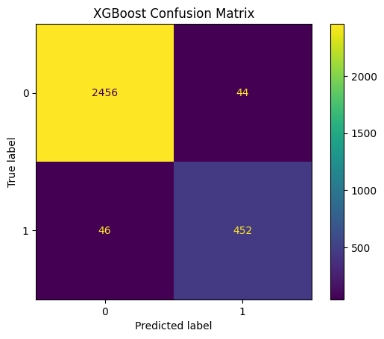
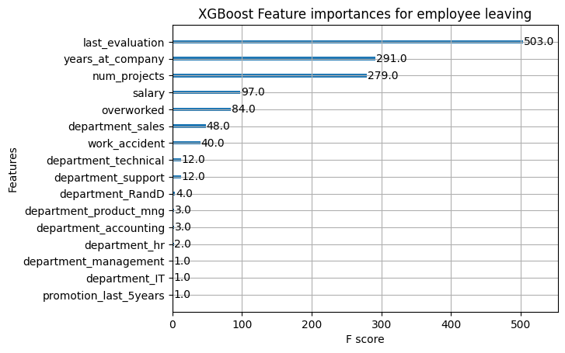
Salifort Motors Employee retention
Overview
Salifort Motors is developing a machine learning model to identify reasons for employee turnover. The aim is to boost retention and cut costs linked to high turnover. This is vital as the company invests significantly in employee recruitment and training.
The Problem
The company is facing financial strain due to high employee turnover. We’re investigating the causes and working to improve the work environment. The key question is: What are the factors driving employees to leave the company?
The Approach
We’re using machine learning models to analyze data and identify the causes of employee attrition. As our target variable is categorical, we’re considering logistic regression or tree-based models.
Details
Confusion Matrix
The model shows a tendency for a higher count of false positives (upper-right quadrant).
This suggests that the model often predicts certain employees will leave the company when, in reality, they stay.
Despite this inclination, it’s crucial to highlight that the model’s overall reliability remains unaffected. It continues to be a valuable instrument in understanding and addressing employee turnover.
XGBoost Feature importances
In our XGBoost model, the variables ‘last_evaluation’, ‘years_at_company’, ‘num_projects’, ‘salary’, and ‘overworked’ emerged as the most influential.
These factors play a significant role in predicting whether an employee will leave the company. Understanding these key drivers can help us develop effective strategies to improve employee retention.
Results Summary
This predictive model has an AUC of 94.5%, indicating that the model is likely to rank a positive observation higher than a negative one. This makes it a robust tool for predicting whether an employee will leave and identifying the most influential factors. Therefore, it serves as an excellent aid for HR in making decisions to improve employee retention.
Reflections/ Next Steps
Reward Overworked Employees: Set up a system for those working long hours, either through financial rewards or balanced work hours. Recognize and incentivize hard work through bonuses or public recognition. Conduct regular performance reviews for self-improvement
Promote Fairness: Ensure transparent promotion policies. Investigate departments with low promotion rates. Set clear promotion criteria for employee understanding.
Employee Tenure: Consider promoting employees with at least four years of tenure or investigate dissatisfaction among them.
Workload Management: Limit the number of projects per employee to 3-4.
Recognition System: Establish a system to acknowledge employee contributions.
Exit Feedback: Collect feedback from departing employees for insights.

